Slide 1
Welcome to
Western Washington University

Slide 2

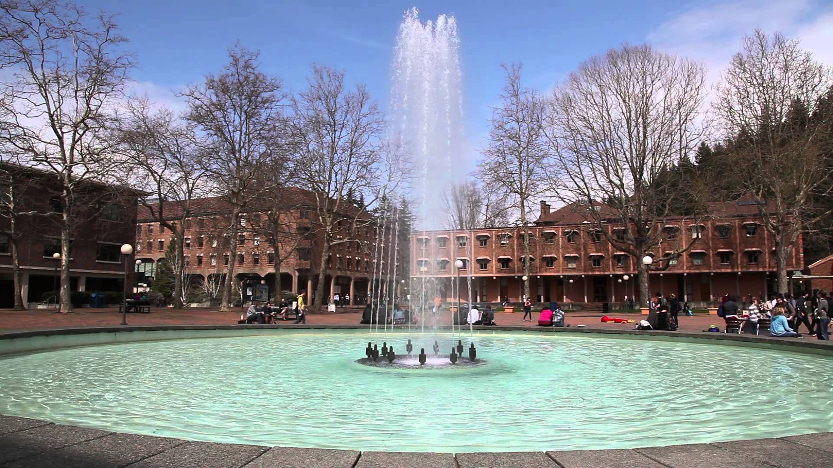

Where’s Western Washington University?
Bellingham, Washington (population of 82,000)
100 km north of Seattle
70 km south of Vancouver, Canada
65 km to Mt. Baker Ski Area
0 km to Puget Sound
Top 100 Best Places to Live and Launch - CNN Money
Top 100 Best Places to Live – Liveabilty.com

Slide 3
Western by the Numbers
15,332 students
160+ academic programs
99% of classes are taught by faculty, not graduate assistants
79% of Western's faculty hold the highest degree in their field
18:1 student-to-faculty ratio
28 is the average class size
73% of classes have 40 or fewer students

Slide 4



National Recognition
Western Washington University is the ranked #1 for public, master’s-granting universities in the Pacific Northwest (2016 U.S. News & World Report).
Western is ranked #2 among public masters-granting institutions for student Fulbright Scholarships.
For the third straight year, Western ranks #1 in the U.S. among medium-sized universities sending its graduates to the Peace Corps.

Slide 5
Western’s Academic Colleges
College of Business and Economics, 1334 majors
College Of Fine and Performing Arts, 700 majors
College of Humanities and Social Sciences, 3497 majors
College of Science and Engineering, 2130 majors
Fairhaven College of Interdisciplinary Studies, 173 majors
Huxley College of the Environment, 686 majors
Woodring College of Education, 749 majors
Graduate School, 701 students

Slide 6
At Western…
  The student experience matters
  We create a great learning environment
  Faculty work closely with students
  We help students reach their potential
  Students volunteer 1 million hours annually
  Undergraduates participate in faculty research

Slide 7


Beautiful location!

Slide 8

Western’s campus
Virtual Visit of campus
Tour of the dorms

Slide 9
International Exchanges
Students coming to study at Western:
178 Degree and Exchange International Students (2016)
Top Countries of Origin: Japan, Canada, China, Vietnam
Top Field of Study by International Students: Business
Western students studying abroad:
More than 600 Western Students Study Abroad (2015-16)
Top Countries for Study: Spain; Japan

Slide 10
Come study with us!

